Slide 1

IEUK Work Sample
By: Ion Temciuc

Slide 2
Intro
For this project I will be taking the role of a Project Manager(PM) for a start-up company that I recently joined, RunWize. The main objective I must achieve as the PM is to enhance user engagement and subscription growth.
The key results are set as follows:
Achieve a 15% increase in Monthly Average Users (MAU)
within six months.
Increase the paid subscriber count by 20% within six
months.

Slide 3
Current company state
Company has been on the market for just over a year
Has the main goal to become nr.1 fitness app in UK
Has apps for Android, IOS and for Smart Watches
Mission: Empower runners, transform lives, and create a
vibrant community that thrives on health, resilience, and
boundless achievement.

Slide 4
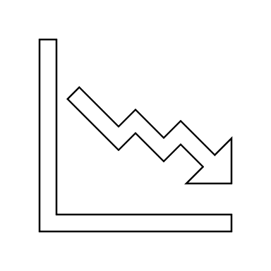
Problem faced
In the past three months, the number of monthly
app users has declined, as well as a churn of 10% in our paid
subscribers since the start of this year.
(insert image of declining trend )

Slide 5
Current Features
GPS route tracking, which informs users
about their route distance
Users can design runs of 5k, 10k and 20k routes
on a map before setting off
Users can set notification reminders to run on specific days
Tracking metrics about a particular run including
pace, heart rate, stride length, and cadence (when
using a compatible watch)
Users can set weekly distance targets

Slide 6

Our users feedback
1. "The weekly distance targets can be discouraging for
someone just starting out. I’d like more flexibility in setting
achievable goals that match my fitness level."
2. "The app could provide more guidance on how to interpret
the metrics like stride length and cadence. As a beginner, I’m
not sure what these mean for my running."
3. “The reminders feature doesn’t always send me notifications
on the correct day”
4. "There isn’t enough post-run analysis. I'd appreciate more
detailed feedback on my performance and suggestions on how
to improve."
5. "The app is missing advanced training features like interval
training programs or customisable workout plans tailored to
specific race preparations."
6. "Heart rate data is tracked, but the app doesn’t offer advanced
insights or the ability to create heart rate-based training zones, which
are essential for serious training."
7. "Setting weekly distance targets is useful, but I’d like to set different
types of goals, such as improving my pace or increasing the number of
runs per week."
8. "The app’s social sharing features are quite basic. It would be great to
have more community interaction, like joining virtual running clubs or
participating in challenges."
9. "The reminders to run are helpful, but they lack personalisation. It
would be better if the reminders could adapt to my running habits and
rest days."
10. "I'm concerned about the safety of sharing my running routes
publicly. It would be reassuring if the app had more robust privacy
settings and safety features."

Slide 7
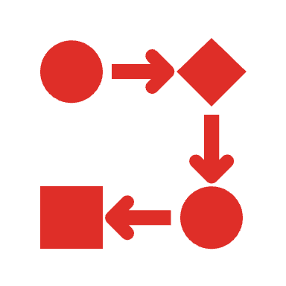
Development plan
For our development, we will be applying the Agile development methodology as this will give us the desired flexibility in terms of implementation of new features, testing and roll-out. This will also allow us to go back in development cycle, change and adapt to the situation down the line if required.

Slide 8
Step by step plan
Competitors research/ analysis
Analyze main competitors, find what features they implemented, their users feedback, where they are better than us, where we are better. Understand what features work best and what we can implement in our app.

Slide 9
2. Finalize the market research, determine which features we are going to implement, decide how achievable this is for our team, assign roles and tasks, determine the technologies needed to implement the features.
3. Development/ design stage
At this stage we are going to design, develop and test new features, all at the same time, one feature at the time depending on their priority level.

Slide 10
4. Feature roll-out
At this stage, we are going to rollout features one by one after successful development and testing is done. The features will be rolled out while the app will be still live through an update of the app in the marketplace.
5. Reflection and analyzing results
Here we will look if the implemented features have had an impact on users growth, and if it aligned with pre-set objectives.

Slide 11
Timeline
We were given only 6 months to complete this project, so time is the biggest challenge, plus the small team might be challenging too. To make it easier for me do split the plan into weeks of work, I will splint the month in week which 6 month equals to 24 weeks
First 2 weeks i will carry a market/ competitors research and analysis, that’s step 1 of the plan.
3rd week, I will evaluate the findings, and discuss them with my team to see how achievable it is for us.
Starting with week 4 up to week 22, the team will be designing, developing and testing new features. The team will be working on 1 feature at the time until its ready to be launched, then move to next one. To split to work between two engineers, 1 will develop and other will take care of testing.

Slide 12
4. Last two weeks, will be used in case we will need additional time , and to analyze the results against main objectives for this project. We will look at numbers, users charts, paid subscriptions numbers.

Slide 13
Competitors Research

Slide 14
After carrying a market and competitors research of the main players on the fitness apps market, I came to a conclusion that our company has already implemented most of the features that such an app could possibly have. However, there are few ideas that could help us with users satisfaction by addressing their feedback. Some of these new features will be free, some will require paid monthly subscription of £2, while other companies offer these features at a much higher monthly price, which will put us in a good position. I believe this is a reasonable price for all the features app will provide. This will also allow us to increase the profit from the app. These subscription based features will be offered as a 30 days trial free of charge for everyone, to allow users to try these new features out without risk.

Slide 15
Is community and social sharing features (paid subscription required)
  The feedback nr.8 mention “The app’s social sharing features are quite basic. It would be great to have more community interaction, like joining virtual running clubs or participating in challenges” . With this we could add the feature to connect with friends, share progress, and participate in challenges.
  2. Sleep tracker (free for everyone)
  To track users sleep, advice on how they can improve it and give them stats on how well they slept over the days. Such feature can be found in FitBit and Apple watch.

Slide 16
3. Nutrition and Diet tracking (paid subscription required)
Such a feature would allow users to track their diet, their food intake, count calories, set targets and track their progress to their desired weight. They will have a tab in the app that allows them to add the food they had and the app will automatically count calories and add them to the list.

Slide 17
4. Analytics and Reports (paid subscription required)
  App could generate reports on users activities and health metrics for past day, week or month, to show the progress and achievements, to motivate them. This will address the feedback nr.4 of our users feedback list.
  5. Customization and Personalization
  This feature will allow users to set custom training routine for each individually. This also addresses the feedback nr.7 and nr.9.

Slide 18
Conclusion
This is my development plan for this product, I believe if we will implement the set objectives and features it will allow us to bring more customers on board and increase the number of paid subscriptions.

